Slide 1


What is ?
NTPEP is the National Transportation Product Evaluation Program.
It is a national evaluation and auditing program for manufactured products.
It assists states with their coordinated evaluations on a wide array of
highway safety products
maintenance products
construction materials
Notes:
Budgets cut year after year - Equipment becomes outdated – Retired employees not replaced, or new employees lack experience – Still have to “keep it all working”

Slide 2

Benefits of
Listen as Jason Davis, of Louisiana DOTD, explains.
. . .

Slide 3

LA DOTD involved with since the 1990’s
in the Lead State role
conducting testing for Sign Sheeting Materials and Pavement Marking Materials

Slide 4
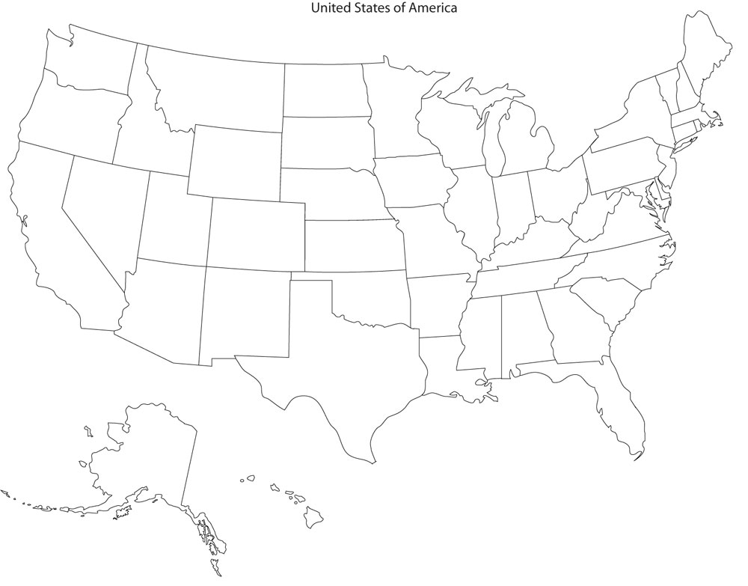
POOLS RESOURCES

Slide 5
POOLS RESOURCES

Slide 6
Evaluations and Audits
BRINGS YOU

Slide 7
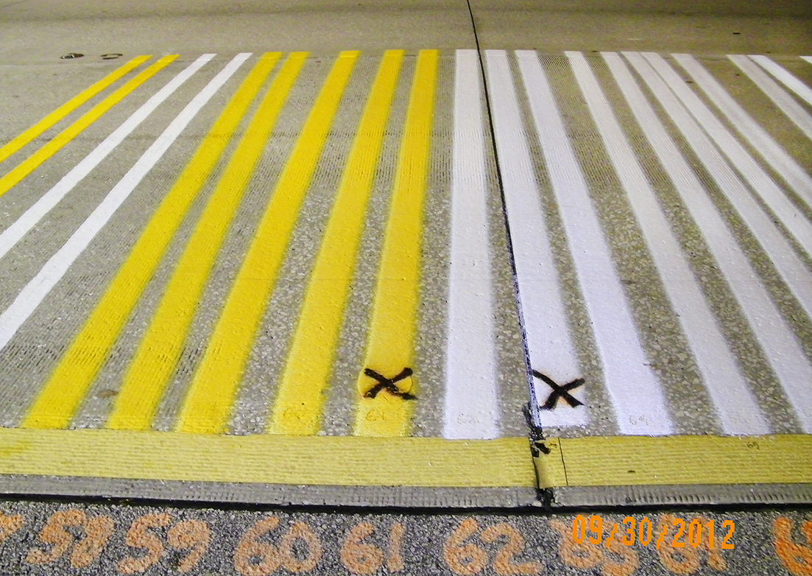
A PMM Test Deck
(This one is in Florida)

Slide 8
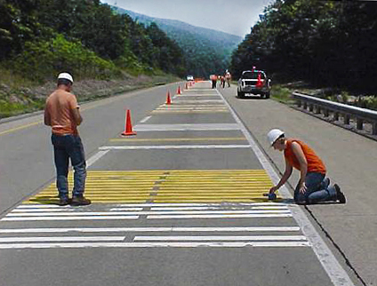
A PMM Test Deck
(This one is in Pennsylvania)

Slide 9

Copy Another Lab’s Results !
Notes:
It isn’t cheating if the administration approves it.

Slide 10

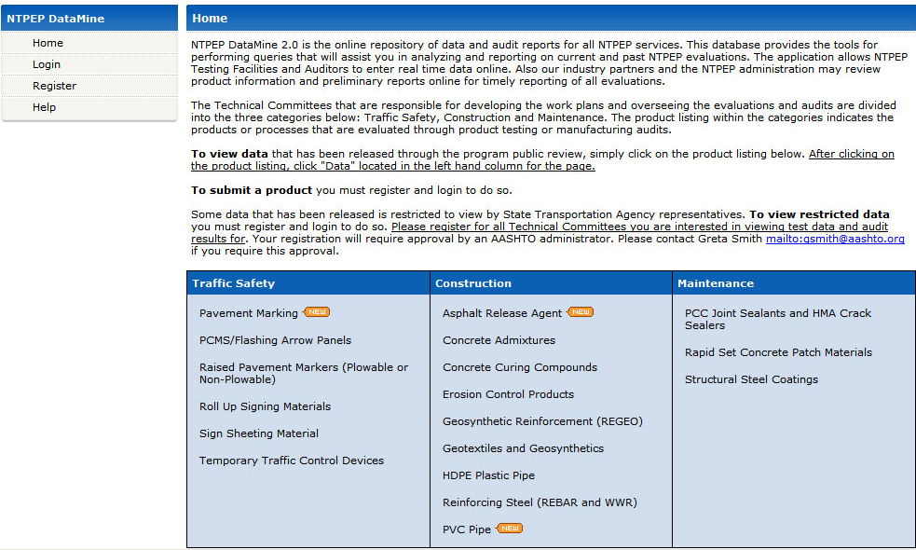
DataMine 2.0
By using

Slide 11
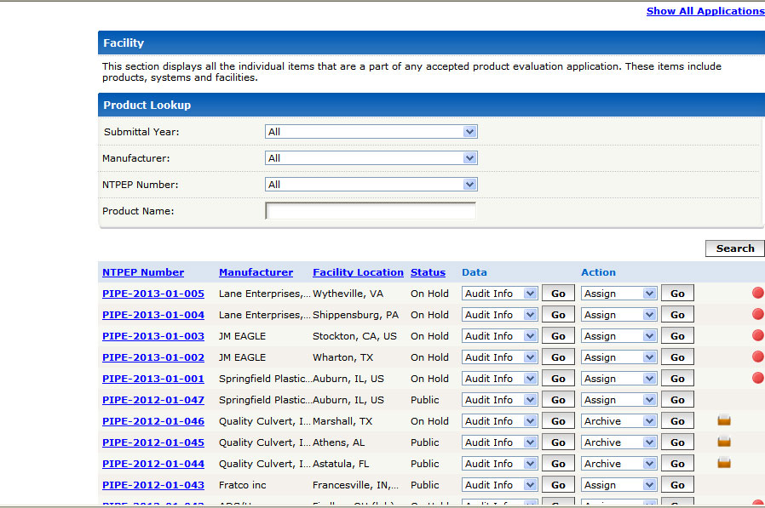
DataMine 2.0

Slide 12
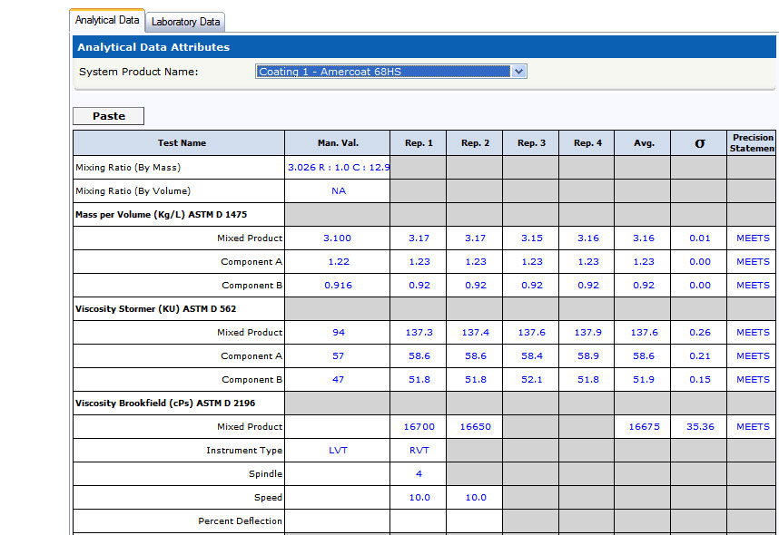
DataMine 2.0

Slide 13
DataMine 2.0
Add products to your State’s Qualified Products List
See what else is out there
Approve testing facilities
Compare product performance

Slide 14
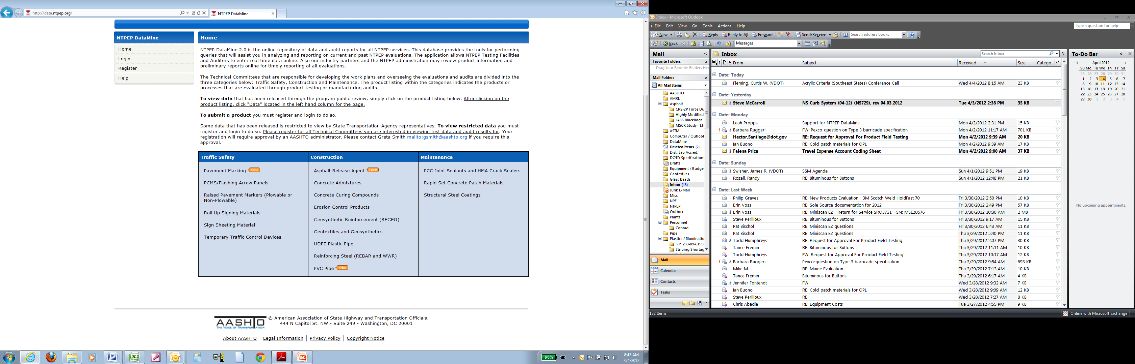
DataMine 2.0
Data is just a mouse-click away
http://data.ntpep.org/
State users and industry users
are welcome to register
http://data.ntpep.org/Help.aspx
Notes:
DataMine to give easy access to data, company information, audit results, and contact information

Slide 15
Work Plans
YOU BRING

Slide 16

State Members- Have Your Say!
Help develop protocols for the Project Work Plan.
Members attend annual meetings and vote.

Slide 17

State Members- Have Your Say!
Work Plans outline the standards a plant or manufacturer must meet in order to receive a NTPEP certificate of compliance.
Data is collected according to laboratory testing and field evaluation protocols developed through consensus-based decision by NTPEP’s Oversight.
Notes:
Budgets cut year after year - Equipment becomes outdated – Retired employees not replaced, or new employees lack experience – Still have to “keep it all working”

Slide 18

SAVES MONEY

Slide 19
Saved Louisiana $$$
Product & Average Yearly Savings 2006-2011
SSM (w/ field) | $ 5,760 | PIPE | $ 3,000
PMM (w/ field) | $ 5,600 | TTCD | $ 5,700
GTX | $ 3,420 | RSCP | $ 360
JS | $ 300 | CCC | $ 200
RPM (w/ field) | $ 5,090 | REBAR | $ 6,600
SSC | $ 31,920
Total | $ 67,950
Notes:
Items currently approved using NTPEP data

Slide 20

Members pay a voluntary fee
The 2013 Annual Fee
= $12,000
It is worth it.

Slide 21
Consider the Intangibles
Experience counts!
Training takes time and $$
Test states have experience with large test decks and specific materials
Personnel available for scheduled audits
No time away from “regular” job
Notes:
Save resources by not spending time and money training employees for lab / field tests and audits.
Test decks and audits require experience and take time away from work

Slide 22

Potential Savings
Savings to traveling public
May need less testing
Competition may lower costs
LA 2011 – app. 3000 lane miles striped
5% price reduction = $225,000 saved

Slide 23
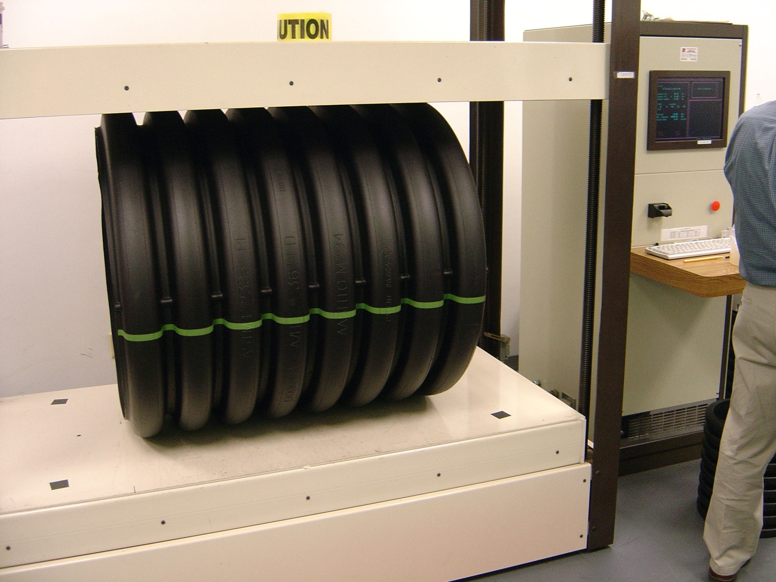
PIPE stiffness test

Slide 24
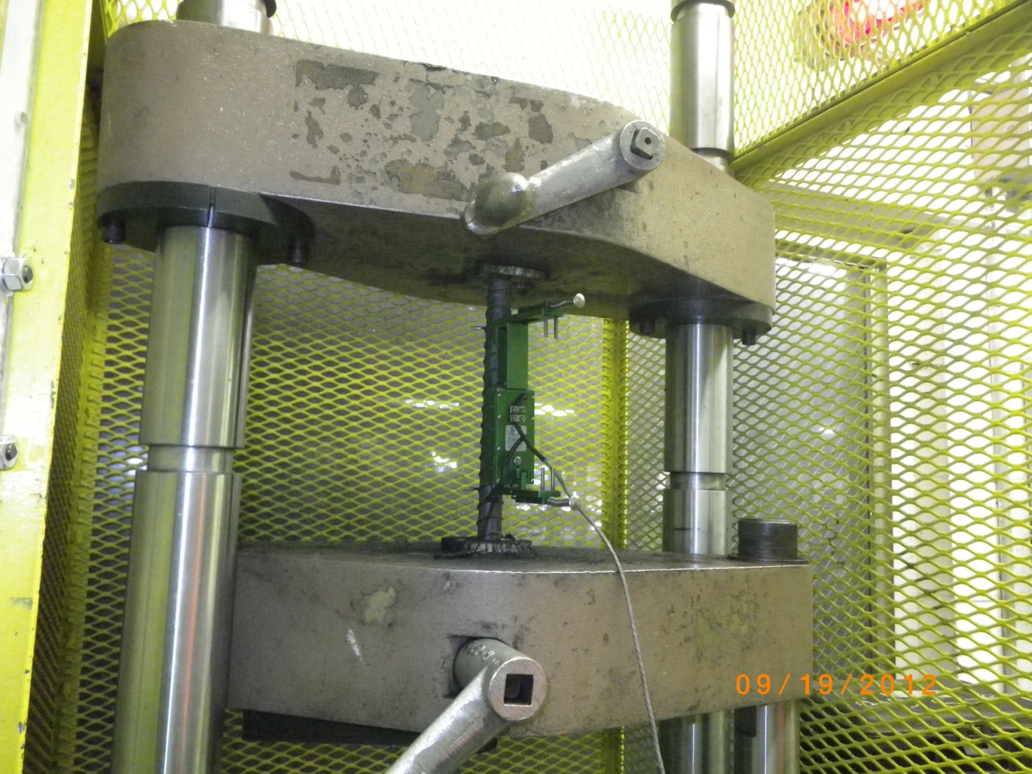
REBAR test for tensile strength

Slide 25

Geotextile Audits

Slide 26
Consider the Intangibles
Without NTPEP, States could:
1) Test products only when submitted
- BUT multiple work zones = costs and hazards
2) Wait for enough submittals
-Better cost efficiency, BUT delays
3) Skip the field test
- HOPE FOR THE BEST!
Notes:
Example of PMM – field testing as products are submitted is not cost efficient, while waiting for a “group” is not time efficient – no field testing may be worse

Slide 27
Value Added
BRINGS YOU
Notes:
We still need good results, but we don’t have the money to test everything.

Slide 28

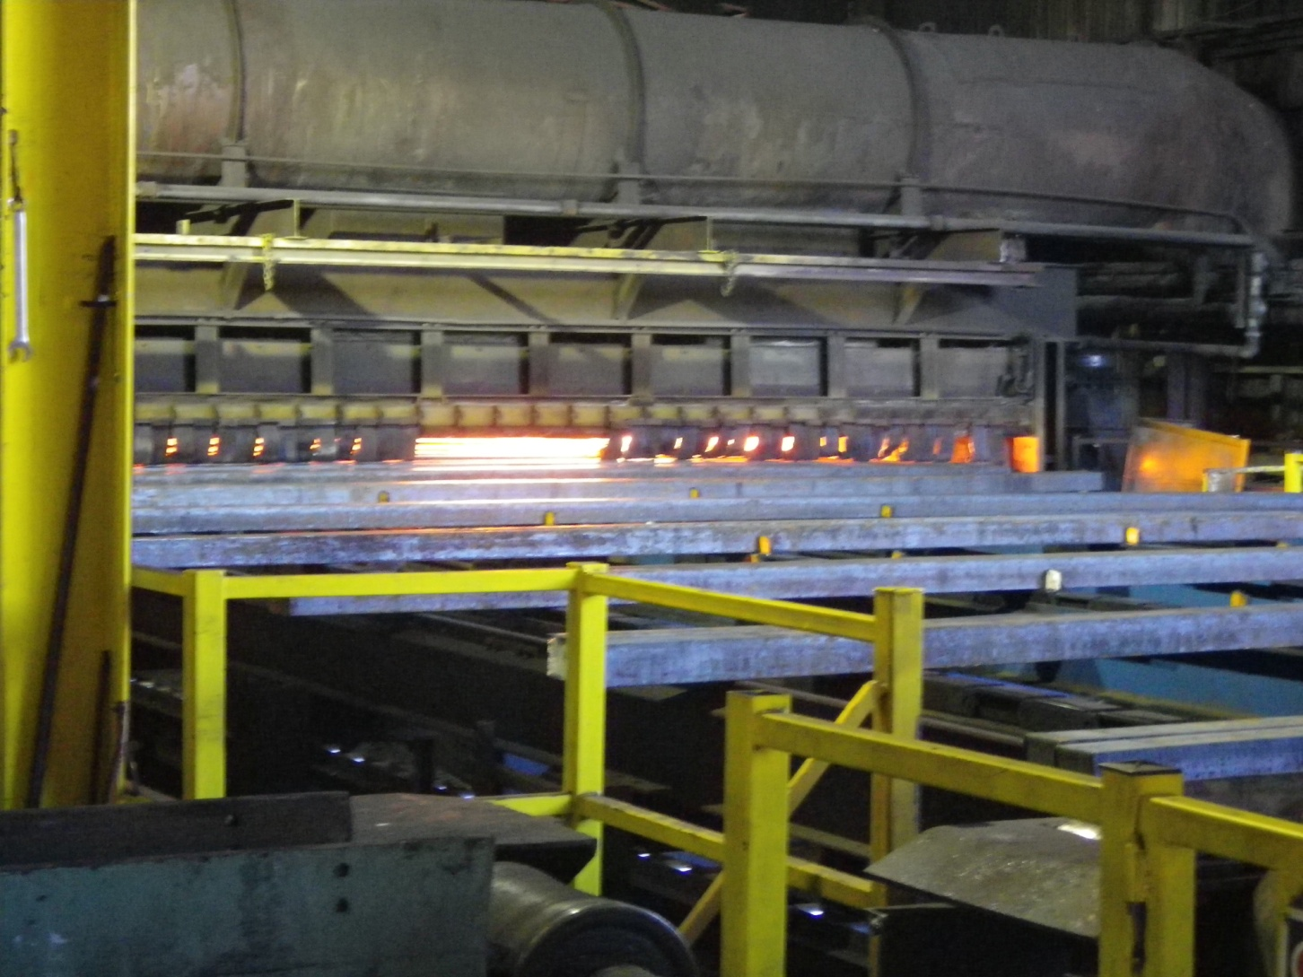
Confidence in your materials

Slide 29

Quality Control Audits

Slide 30
Value Added
Potential Product & Average Yearly Savings
SSM (w/ field) | $ 5,760 | PIPE (w/ audit) | $ 29,750
PMM (w/ field) | $ 5,600 | TTCD | $ 5,700
GTX (w/ audit) | $ 21,600 | RSCP (w/ field) | $ 4,500
JS (w/ field) | $ 4,500 | CCC | $ 200
RPM (w/ field) | $ 5,090 | REBAR (w/ audit) | $ 65,450
SSC | $ 31,920 | ARA | $ 7,600
CADD | $ 2,520 | CS (w/ field) | $ 4,350
Total | $194,540

Slide 31
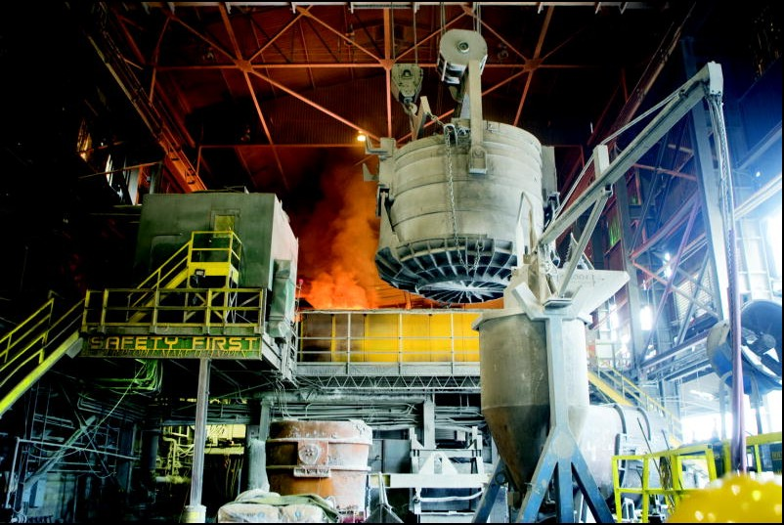
Confidence in Evaluations

Slide 32




BENEFITS OF
Reliable results
Data just a mouse-click away
Real savings
Save resources for better things

Slide 33
BENEFITS OF
Special thanks to Jason Davis of
Louisiana DOTD
If you have questions, please contact:
Lindsay Brown Lindsay.Brown@aashto.org
Evan Rothblatt erothblatt@aashto.org
Katheryn Malusky kmalusky@aashto.org
Greta Smith gsmith@aashto.org

